Slide 1

MCP
Dima Ionut Daniel

Slide 2
Contents
What is MCP?
History
Adoption
Features
Architecture
Concepts
Evolution
Core
Security
MCP vs A2A
Conclusion
Bibliography

Slide 3

What is MCP?
The Model Context Protocol (MCP) is an open standard, open-source framework introduced by Anthropic to standardize the way artificial intelligence (AI) models like large language models (LLMs) integrate and share data with external tools, systems, and data sources.
MCP provides a model-agnostic universal interface for reading files, executing functions, and handling contextual prompts.

Slide 4
History
The protocol was announced in November 2024 as an open standard for connecting AI assistants to data systems such as content repositories, business management tools, and development environments.
MCP was designed as a response to this challenge, offering a universal protocol for interfacing any AI assistant with any structured tool or data layer.
The protocol was released with software development kits (SDK) in multiple programming languages, including Python, TypeScript, Java, and C#.

Slide 5
Adoption
In March 2025, OpenAI officially adopted the MCP, following a decision to integrate the standard across its products, including the ChatGPT desktop app, OpenAI's Agents SDK, and the Responses API.
By adopting MCP, OpenAI joins other organizations such as Block, Replit, and Sourcegraph in incorporating the protocol into their platforms.
Demis Hassabis, CEO of Google DeepMind, confirmed in April 2025 MCP support in the upcoming Gemini models and related infrastructure, describing the protocol as "rapidly becoming an open standard for the AI agentic era".

Slide 6
Features
Data ingestion and transformation
Contextual metadata tagging
Model interoperability across platforms
Secure, two-way connections between data sources and AI-powered tools

Slide 7
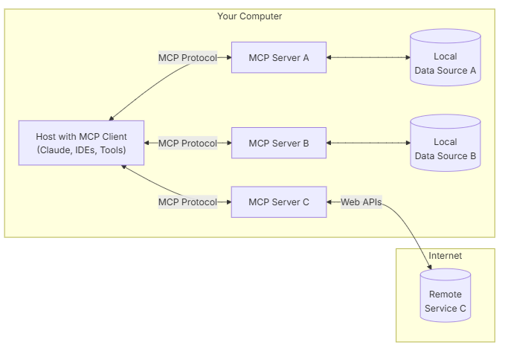
Architecture
MCP follows a client-server architecture where a host application can connect to multiple servers

Slide 8
Concepts
MCP Hosts: Programs like Cursor, Claude Desktop, IDEs, or AI tools that want to access data through MCP
MCP Clients: Protocol clients that maintain 1:1 connections with servers
MCP Servers: Lightweight programs that each expose specific capabilities through the standardized Model Context Protocol
Local Data Sources: Your computer’s files, databases, and services that MCP servers can securely access
Remote Services: External systems available over the internet via APIs that MCP servers can connect to

Slide 9
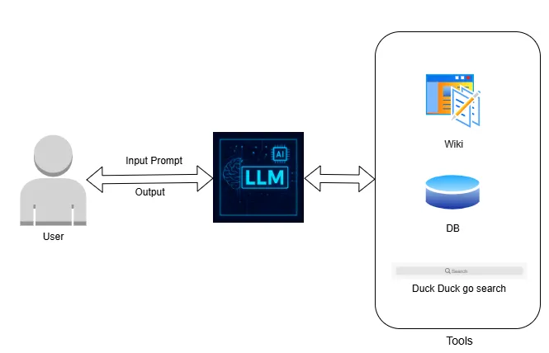
Evolution
In the early phase of LLM integration, applications followed a simple linear flow.
This was sufficient for basic use cases like summarization, translation, or casual conversation.
To handle more complex tasks, developers started integrating external tools like APIs, databases, code repositories, and more.

Slide 10
Evolution (cont.)
While this expanded the capabilities of LLMs significantly, it introduced new challenges:
Developers had to manually configure each tool.
Every change in tool setup required code modifications.
As the number of tools grew, so did the complexity of tool management and integration logic.

Slide 11
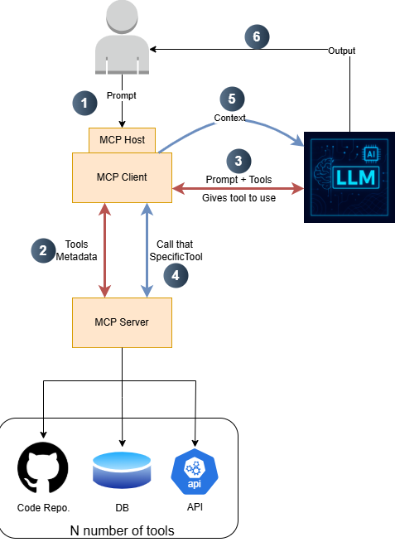
Evolution (cont.)
Anthropic Introduced Model Context Protocol (MCP), that addresses these issues by offering a standardized way to describe and connect tools, APIs, and contextual information to LLMs.
With MCP, everything is modular, pluggable, and defined through a common protocol.

Slide 12
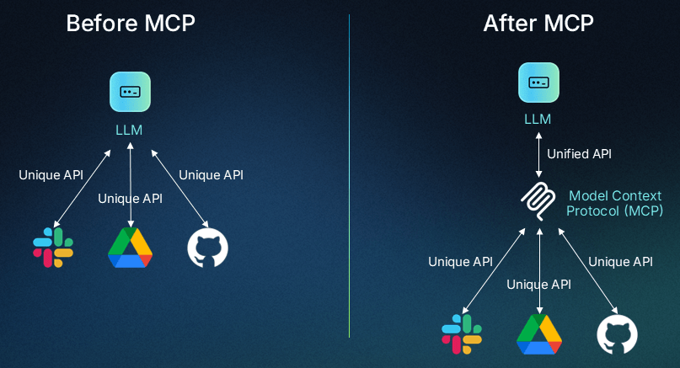
Evolution (cont.)
MCP addresses this challenge by providing a standardized way for LLMs to connect with external data sources and tools—essentially a “universal remote” for AI apps.

Slide 13
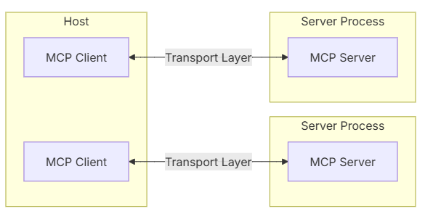
Core
The Model Context Protocol (MCP) is built on a flexible, extensible architecture that enables seamless communication between LLM applications and integrations.
MCP follows a client-server architecture where:
Hosts are LLM applications (like Claude Desktop or IDEs) that initiate connections
Clients maintain 1:1 connections with servers, inside the host application
Servers provide context, tools, and prompts to clients

Slide 14
Core (cont.)
The transport layer handles the actual communication between clients and servers. MCP supports multiple transport mechanisms:
Stdio transport
Uses standard input/output for communication
Ideal for local processes
HTTP with SSE transport
Uses Server-Sent Events for server-to-client messages
HTTP POST for client-to-server messages
All transports use JSON-RPC 2.0 to exchange messages.

Slide 15
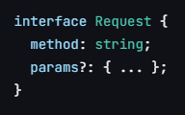

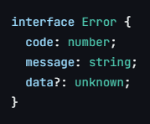
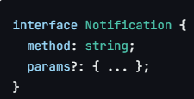
Core (cont.)
MCP has these main types of messages:
Requests expect a response from the other side
Results are successful responses to requests
Errors indicate that a request failed
Notifications are one-way messages that don’t expect a response

Slide 16
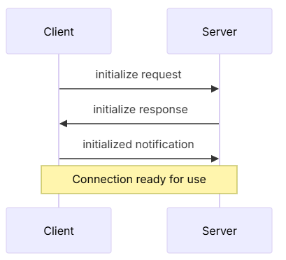
Core (cont.)
Connection lifecycle
1. Client sends initialize request with protocol version and capabilities
2. Server responds with its protocol version and capabilities
3. Client sends initialized notification as acknowledgment
4. Normal message exchange begins

Slide 17
Core (cont.)
Message exchange
After initialization, the following patterns are supported:
Request-Response: Client or server sends requests, the other responds
Notifications: Either party sends one-way messages

Slide 18
Core (cont.)
Best practices, transport selection:
1. Local communication
Use stdio transport for local processes
Efficient for same-machine communication
Simple process management
2. Remote communication
Use SSE for scenarios requiring HTTP compatibility
Consider security implications including authentication and authorization

Slide 19
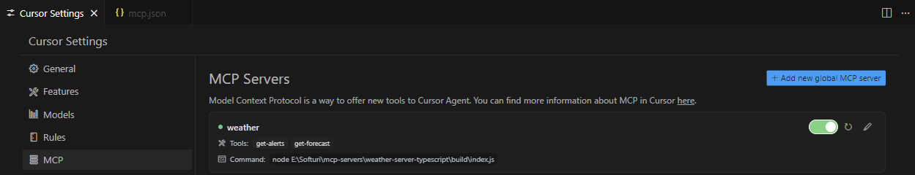
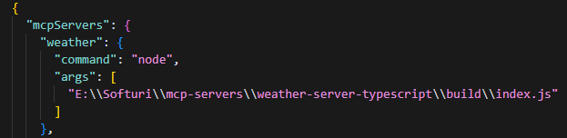
Core (cont.)
Using Cursor Desktop we can configure local MCP servers

Slide 20
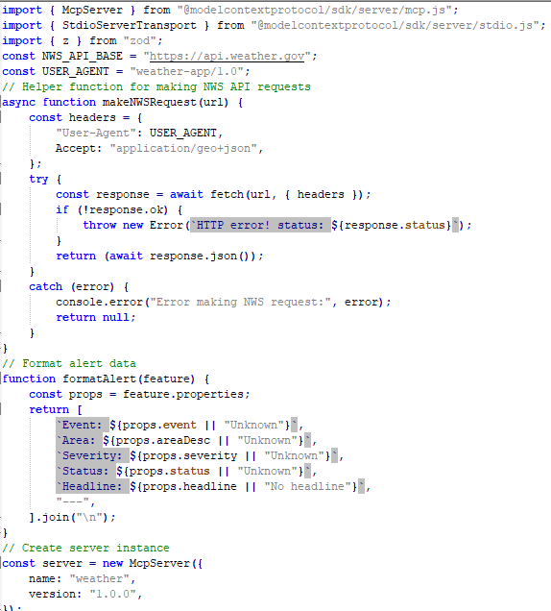
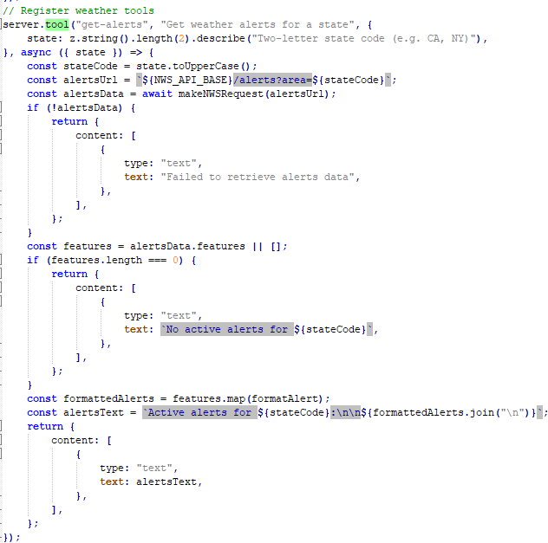
Core (cont.)
MCP Servers can be developed in TypeScript, Python, Java, Kotlin, C#, Swift.

Slide 21
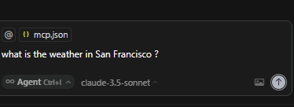
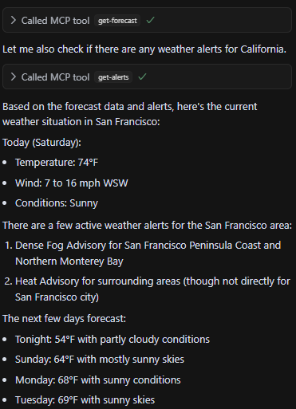
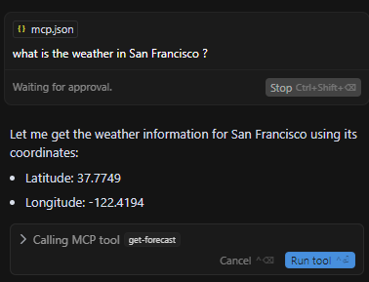
Core (cont.)
We’ll be asked by Cursor Desktop to gave permission to use the tools

Slide 22
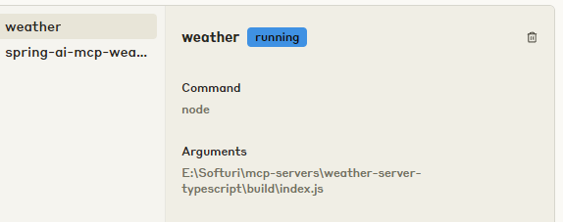
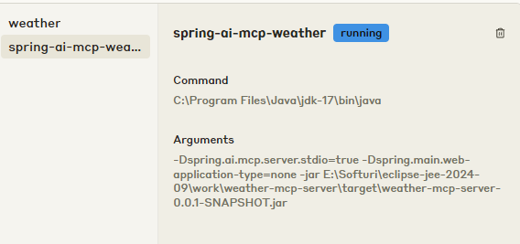
Core (cont.)
Cloud Desktop can also be configured to use MCP servers File → Settings

Slide 23
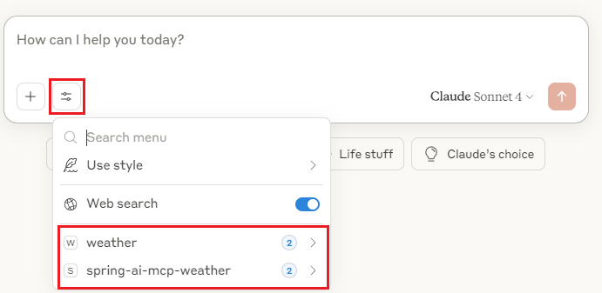
Core (cont.)
Claude can see the detected tools once we’ve setup the MCP servers

Slide 24
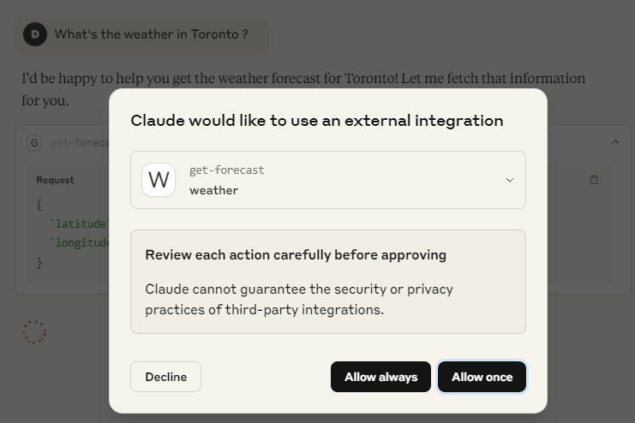
Core (cont.)
Claude Desktop will ask for permission to run the tool.

Slide 25
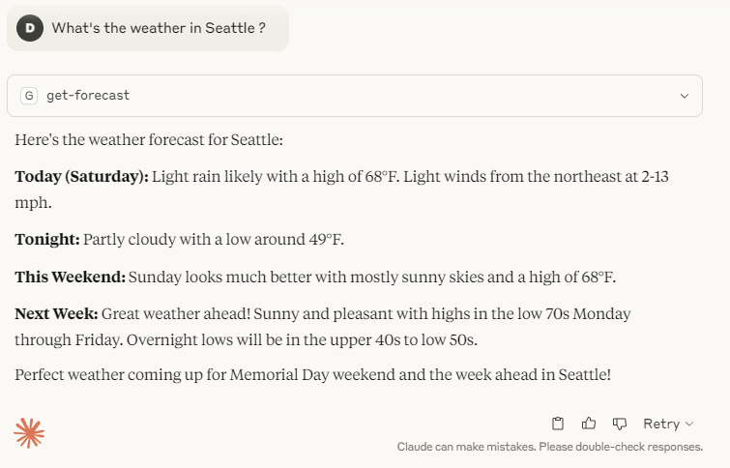
Core (cont.)
After we gave permission to Claude Desktop to make the MCP call we can receive the results

Slide 26
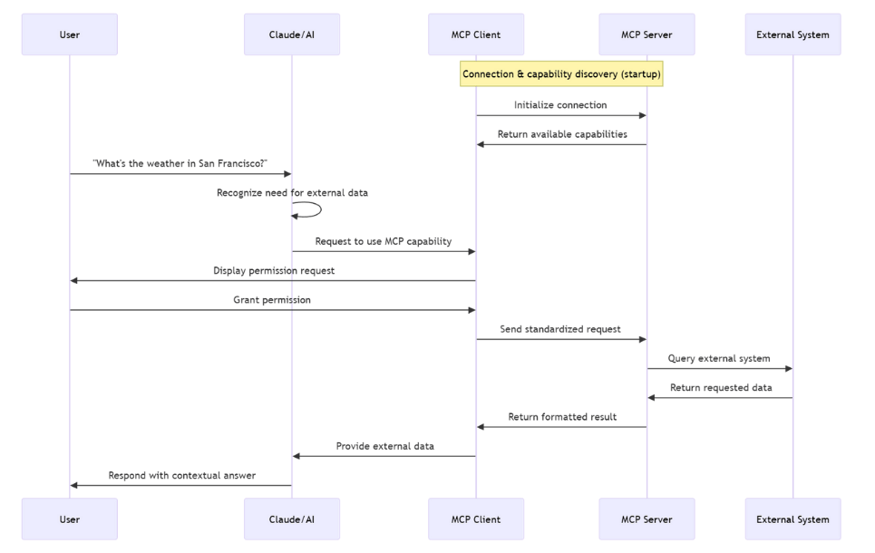
Core (cont.)

Slide 27
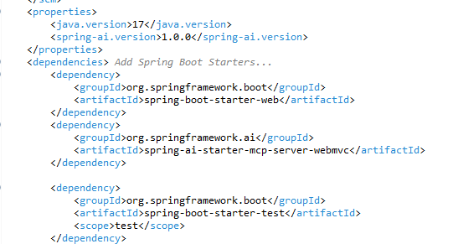
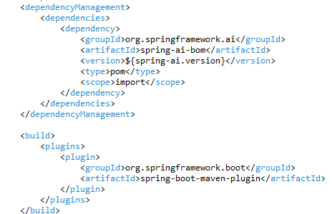
Core (cont.)
In Java we can develop MCP client & servers using Spring AI.

Slide 28
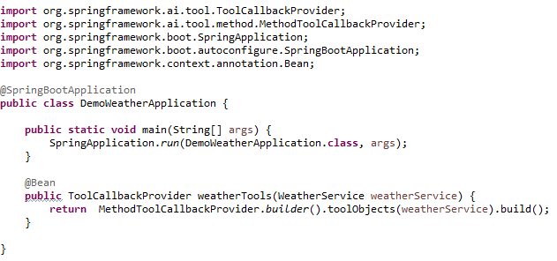
Core (cont.)
We need to define the Spring Boot Application

Slide 29
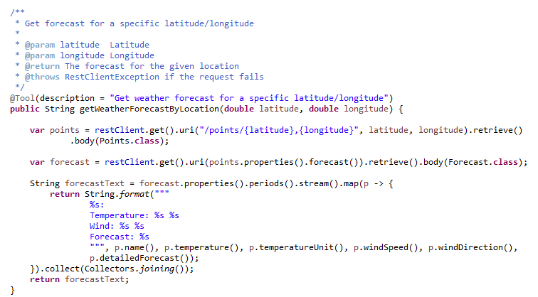
Core (cont.)
For the Weather service, we use the define a @Service bean class and use the @Tool annotation to define the exposed methods.

Slide 30
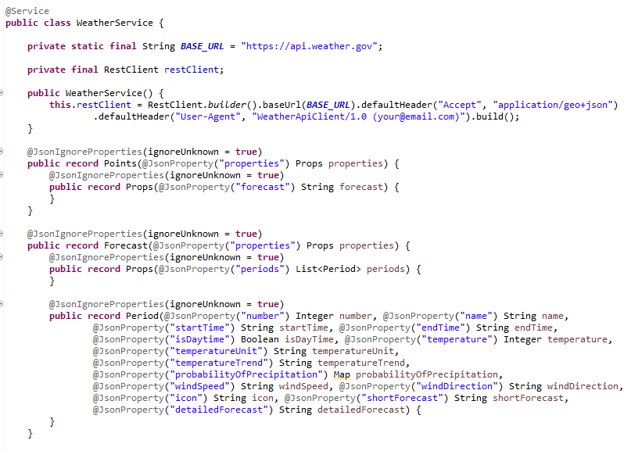
Core (cont.)

Slide 31
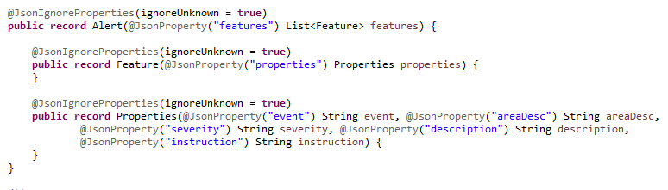
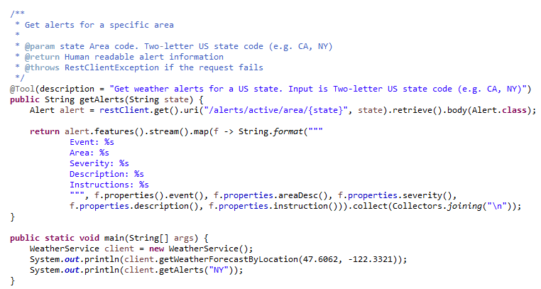
Core (cont.)

Slide 32
Core (cont.)
To start the MCP Server developed with Spring AI we need to use the following command::
java -Dspring.ai.mcp.server.stdio=true Dspring.main.web-application-type=none -Dspring.main.banner-mode=off -Dlogging.level.root=OFF -jar target/weather-mcp-server-0.0.1-SNAPSHOT.jar
This will start the Weather Spring application in STDIO mode.
By default the microservice starts in WebMVC SSE mode.

Slide 33
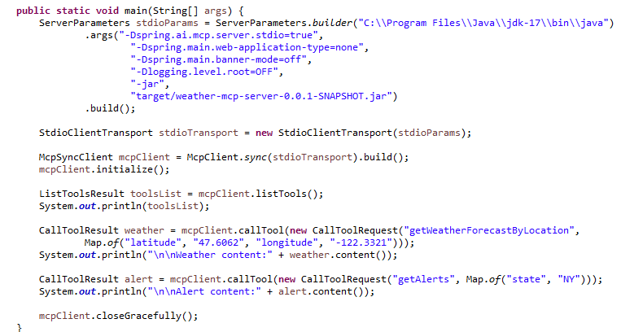
Core (cont.)
We can test the MCP server by using a MCP client

Slide 34

Core (cont.)
We can inspect MCP servers using MCP inspector.
As example we start the typescript weather MCP Server : node E:\Softuri\mcp-servers\weather-server-typescript\build\index.js
We start MCP inspector: npx @modelcontextprotocol/inspector E:\Softuri\mcp-servers\weather-server-typescript\build\index.js

Slide 35
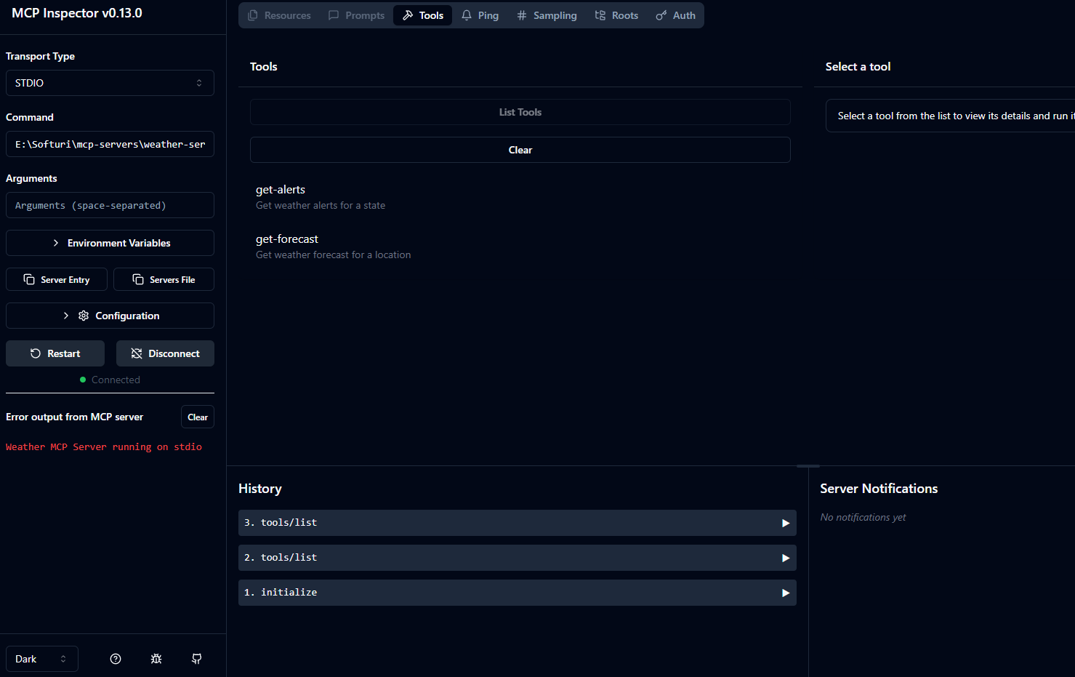
Core (cont.)
We can access the MCP inspector using a browser http://localhost:6274

Slide 36
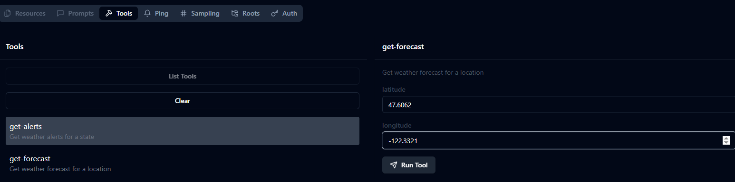
Core (cont.)
We can run the get-alert tool

Slide 37
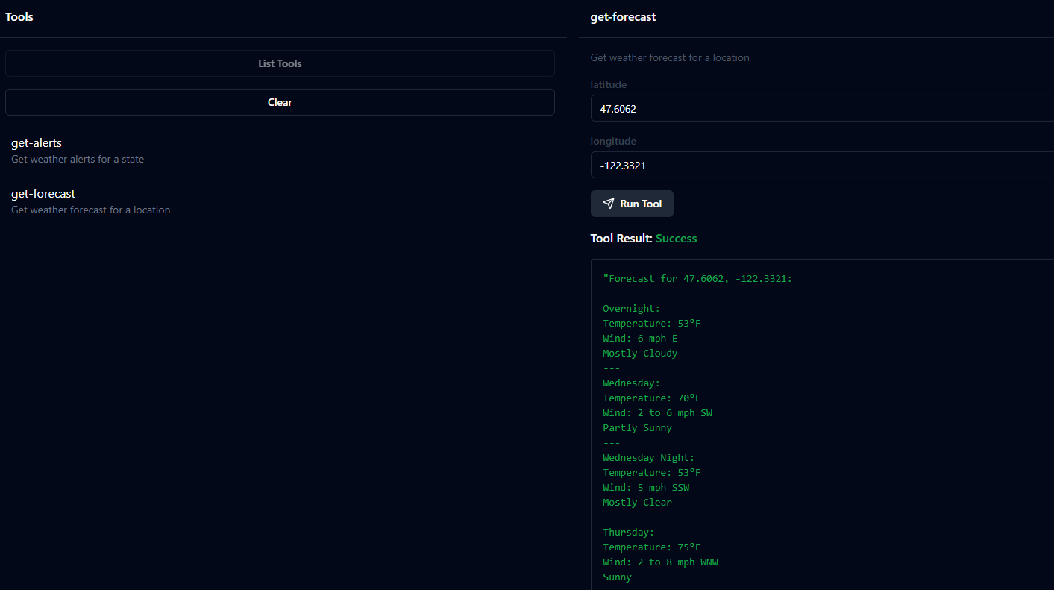
Core (cont.)

Slide 38
Core (cont.)
Resources expose data and content from your servers to LLMs
Resources represent any kind of data that an MCP server wants to make available to clients.
File contents
Database records
API responses
Live system data
Screenshots and images
Log files

Slide 39
Core (cont.)
Each resource is identified by a unique URI and can contain either text or binary data.
[protocol]://[host]/[path]
Example:
file:///home/user/documents/report.pdf
postgres://database/customers/schema
screen://localhost/display1

Slide 40
Core (cont.)
Tools enable LLMs to perform actions through your server.
Tools are a powerful primitive in the MCP that enable servers to expose executable functionality to clients. Key aspects of tools include:
Discovery: Clients can list available tools through the tools/list endpoint
Invocation: Tools are called using the tools/call endpoint, where servers perform the requested operation and return results
Flexibility: Tools can range from simple calculations to complex API interactions

Slide 41
Core (cont.)
Prompts create reusable prompt templates and workflows
Prompts enable servers to define reusable prompt templates and workflows that clients can easily surface to users and LLMs.
They provide a powerful way to standardize and share common LLM interactions.
Prompts in MCP are predefined templates that can:
Accept dynamic arguments
Include context from resources
Chain multiple interactions
Guide specific workflows
Surface as UI elements (like slash commands)

Slide 42
Core (cont.)
Sampling let your servers request completions from LLMs
Sampling is a powerful MCP feature that allows servers to request LLM completions through the client, enabling sophisticated agentic behaviors while maintaining security and privacy.
The sampling flow follows these steps:
Server sends a sampling/createMessage request to the client
Client reviews the request and can modify it
Client samples from an LLM
Client reviews the completion
Client returns the result to the server

Slide 43
Core (cont.)
Roots are a concept in MCP that define the boundaries where servers can operate.
They provide a way for clients to inform servers about relevant resources and their locations.
A root is a URI that a client suggests a server should focus on.
When a client connects to a server, it declares which roots the server should work with.
While primarily used for filesystem paths, roots can be any valid URI including HTTP URLs.
Example:
file:///home/user/projects/myapp
https://api.example.com/v1

Slide 44
Security
Security considerations for MCP servers:
MCP’s OAuth implementation using HTTP+SSE transport servers exhibits the same risks as standard OAuth flows.
Developers should be vigilant about open redirect vulnerabilities, properly secure tokens, and implement PKCE for all authorization code flows.
Vulnerability Distribution
Command Injection Vulnerabilities: 43% of tested implementations contained command injection flaws
Path Traversal/Arbitrary File Read: 22% allowed accessing files outside intended directories
SSRF Vulnerabilities: 30% permitted unrestricted URL fetching
Other Security Issues: 5% had miscellaneous security concerns

Slide 45
Security (cont.)
The Universal Attack Surface
MCP servers can be called by anyone, not just LLMs.
While LLMs typically show what they’re going to do with “plan“ and “act“ phases, a malicious attacker has no such transparency.
This creates an expanded attack surface that many developers haven’t properly secured.

Slide 46
Security (cont.)
Missing Secure by Design: Protocol Fundamentals
The Model Context Protocol (MCP) was designed primarily for functionality rather than security, creating fundamental vulnerabilities that cannot be easily patched in implementations.
Session IDs in URLs: The protocol specification mandates session identifiers in URLs (GET /messages/?sessionId=UUID), which fundamentally violates security best practices. This design exposes sensitive identifiers in logs and a session could be hijacked by an attacker.
Lack of Authentication Standards: The protocol provides minimal guidance on authentication, leading to inconsistent and often weak security implementations.
Missing Integrity Controls: The protocol lacks required message signing or verification mechanisms, allowing message tampering.

Slide 47
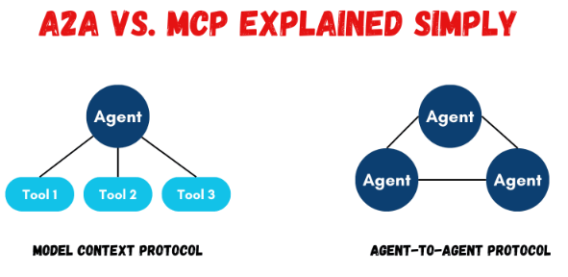
MCP vs A2A
MCP (Model Context Protocol) and A2A (Agent-to-Agent) are two distinct protocols that enable AI agents to interact and collaborate.
MCP facilitates an agent's interaction with external tools, data, and context.
A2A focuses on enabling agents to communicate, share information, and coordinate actions with each other.

Slide 48
MCP vs A2A (cont.)
A2A is a new open protocol (introduced by Google in 2025) for allowing multiple AI agents to find each other, talk, and work together.
In an A2A system, each agent is an independent service with its own capabilities.
Agents expose a network endpoint implementing A2A and a public “Agent Card” (JSON metadata at /.well-known/agent.json) describing their name, skills, endpoint URL, and auth info.
When one agent needs something, it can discover another by fetching its Agent Card, then send it a “task” request via HTTP/JSON-RPC.

Slide 49
MCP vs A2A (cont.)
A2A (Agent-to-Agent):
Focus: Inter-agent communication and collaboration.
Purpose: Enables agents to discover each other, delegate tasks, and coordinate actions as peers.
Example: An agent specializing in email copywriting can collaborate with another agent managing calendar scheduling to create a personalized outreach strategy.
Design: A2A uses HTTP/JSON standards and supports agent discovery and secure delegation.
Benefits: Enables modular, networked, and composable agent ecosystems.

Slide 50
MCP vs A2A (cont.)
Comparison MCP vs A2A
Aspect | MCP | A2A
Architecture | Single-agent (LLM-centric) with tool servers. Client–server: Host+Client (in app) connect to one or more MCP Servers for tools | Multi-agent (peer) network. Client and Remote roles: agents advertise via Agent Cards, then communicate over HTTP/JSON
Core Purpose | Give one agent structured access to external data and APIs. Acts as a "context layer" to enrich an LLM's environment | Enable inter-agent collaboration. Lets agents discover each other, delegate tasks, and share outputs as if on a common team
Data flow | Agent uses tools, resources, and prompt templates. It reads a list of tool descriptions and calls them as needed | Agents exchange tasks, messages, artifacts, and parts. Each task has a lifecycle; messages carry content (text/data) as needed
Modularity | Modular at the tool level: each MCP server is a separate service. But the LLM agent and its reasoning remain one process. | Modular at the agent level: each agent can be separately developed, scaled, or replaced without touching others. New agents with new skills can join the ecosystem.

Slide 51
MCP vs A2A (cont.)
Aspect | MCP | A2A
Maintainability | Requires maintaining one main agent codebase and any number of tool-server endpoints. Changing a tool's interface means updating its server (though the protocol remains standard). | Agents are independent microservices. You can update or roll out a new agent without redeploying others. However, the coordination logic (often a top-level agent or orchestrator) can become more complex.
Scalability | Typically low-latency for tool calls if servers are local or well-provisioned (uses direct HTTP or SSE). Complexity grows with number of tools, but integration is standardized. Can suffer if context windows overflow or too many simultaneous calls. | Overhead of HTTP network calls between agents. Best suited for larger-scale workflows: you can scale by running many agent instances in parallel. Can handle long-running tasks (hours/days) with streaming updates. Relies on asynchronous communication, so throughput depends on network and agent availability.
Capabilities | Excels at structured reasoning: agents can break tasks into predictable steps and verify each. Transparent execution (each step logged), easy to audit. Well-suited for coding assistants, data lookup, or any task needing precise tool use. | Excels at diverse expertise: teams of agents each specialized (finance, NLP, vision, etc.) collaborate. Ideal for complex multi-domain tasks (enterprise workflows, multi-step business processes) where no single agent has all knowledge. Supports rich media (text, audio, video) negotiation.

Slide 52
MCP vs A2A (cont.)
In practice, MCP and A2A complement each other rather than compete.
Google explicitly calls A2A “complementary” to Anthropic’s MCP.
For example, one agent could use MCP internally (chaining multiple tool calls) and then hand off results to another agent via A2A.

Slide 53
Conclusion
Pros:
Consistent Communication
Improved Modularity
Scalable Tool Interface
Separation of Concerns
Dynamic Context
Cons:
Potential for Complexity
Latency
Learning Curve
Security Concerns
Data Exfiltration Risks
Unintentional Data Exposure
Complexity in Implementation

Slide 54

Bibliography
https://en.wikipedia.org/wiki/Model_Context_Protocol
https://modelcontextprotocol.io/introduction
Udemy – MCP Crash Course Complete Model Context Protocol in a Day
https://shyampatel1320.medium.com/revolutionizing-llm-applications-with-model-context-protocol-mcp-3de72828a625
https://www.descope.com/learn/post/mcp
https://equixly.com/blog/2025/03/29/mcp-server-new-security-nightmare
https://www.kdnuggets.com/building-ai-agents-a2a-vs-mcp-explained-simply

